Slide 1

E-commerce 2017 business. technology. society. 13th edition
Accessibility standards-compliant
Copyright © 2018, 2017, 2016 Pearson Education, Inc. All Rights Reserved

Slide 2

E-commerce 2017 business. technology. society.
13th edition
Chapter 1
The Revolution Is Just Beginning

Slide 3
Learning Objectives
學習目標
1.1 Understand why it is important to study e-commerce.
1.2 Define e-commerce, understand how e-commerce differs from e-business, identify the primary technological building blocks underlying e-commerce, and recognize major current themes in e-commerce.
1.3 Identify and describe the unique features of e-commerce technology and discuss their business significance.
1.4 Describe the major types of e-commerce.
1.5 Understand the evolution of e-commerce from its early years to today.
1.6 Describe the major themes underlying the study of e-commerce.
1.7 Identify the major academic disciplines contributing to e-commerce.
了解為什麼研究電子商務很重要。
定義電子商務，了解電子商業與電子商務的不同之處，確定電子商務背後的主要技術基礎，並認識電子商務中當前主要的主題。
識別並描述電子商務技術的獨特功能，並討論其商業重要性。
描述電子商務的主要類型。
了解電子商務從早期到今天的演變。
描述電子商務研究的主要主題。
確定促進電子商務的主要學科。
Notes:
Slide 3 is a list of textbook LO numbers and statements

Slide 4
Uber: The New Face of E-commerce?
Uber：電子商務的新面貌？
Class Discussion
Have you used Uber or any other on-demand service companies?
What is the appeal of these companies for users and providers?
Are there any negative consequences to the increased use of on-demand services like Uber and Airbnb?
您是否使用過Uber或任何其他按需服務公司？
這些公司對用戶和提供商有什麼吸引力？
是否會增加使用Uber和Airbnb等按需服務的負面影響？

Slide 5
The First Thirty Seconds
前三十秒
First 20 years of e-commerce
Just the beginning
Rapid growth and change
Technologies evolve at exponential rates
Disruptive business change
New opportunities
Why study e-commerce
Understand opportunities and risks
Analyze e-commerce ideas, models, issues
前20年的電子商務
只是開始
快速增長和變化
技術以指數速率發展
顛覆性的業務變化
新的機會
為什麼要學習電子商務
了解機會和風險
分析電子商務的想法，模型和問題

Slide 6
Introduction to E-commerce
電子商務簡介
Use of Internet to transact business
Includes Web, mobile browsers and apps
More formally:
Digitally enabled commercial transactions between and among organizations and individuals
利用互聯網處理業務
包括Web，移動瀏覽器和應用程序
更正式的
數位化支持組織和個人之間的商業交易

Slide 7
The Difference Between E-commerce and E-business
電子商務與電子商業的區別
E-business:
Digital enabling of transactions and processes within a firm, involving information systems under firm’s control
Does not include commercial transactions involving an exchange of value across organizational boundaries
電子商業
數位化支持公司內的交易和流程，涉及公司控制下的信息系統
不包括跨組織邊界交換價值的商業交易

Slide 8
Technological Building Blocks Underlying E-commerce
科技建置阻礙內在的電子商務
Internet
World Wide Web
HTML
Deep Web vs. “surface” Web
Mobile platform
Mobile apps
網際網路
全球資訊網路
超文字標示語言
深層網路和表層網路
手機平台
手機應用程式

Slide 9
Insight on Technology: Will Apps Make the Web Irrelevant?
科技見解:應用程式會取代網頁嗎?
Class Discussion
What are the advantages and disadvantages of apps, compared with websites, for mobile users?
What are the benefits of apps for content owners and creators?
Will apps eventually make the Web irrelevant? Why or why not?
課堂討論
對手機用戶來說，跟網站相比，手機應用程式的好處與壞處是什麼?
對內容擁有者和建立者來說，應用程式的優點是什麼?
應用程式會取代網頁嗎? 會 or 不會

Slide 10
Major Trends in E-commerce
電子商務主要趨勢
Business trends include:
All forms of e-commerce show very strong growth
Technology trends include:
Mobile platform has made mobile e-commerce reality
Societal trends include:
Increased online social interaction and sharing
商業趨勢包含:
所有電子商務的種類都大量增長
科技趨勢包含:
手機平台實現了手機電子商務
社會趨勢包含:
增加線上社交的互動和分享

Slide 11
Unique Features of E-commerce Technology (1 of 2)
電子商務的特色
Ubiquity
Global reach
Universal standards
Information richness
無所不在
全球皆可用
全球標準
資訊豐富
Notes:
Additional concepts and terminology include: Information asymmetry, menu costs, marketplaces and marketspaces, transaction costs, cognitive energy, market entry costs, search costs, price discovery, network externalities.

Slide 12
Unique Features of E-commerce Technology (2 of 2)
電子商務的特色
Interactivity
Information density Personalization/customization
Social technology
互動性
資訊密集度
個人化/客製化
社交技術
Notes:
Additional concepts and terminology include price transparency, cost transparency, and price discrimination.

Slide 13
Types of E-commerce
電子商務的種類
Business-to-Consumer (B2C)
Business-to-Business (B2B)
Consumer-to-Consumer (C2C)
Mobile e-commerce (M-commerce)
Social e-commerce
Local e-commerce
企業對消費者（B2C）
企業對企業（B2B）
消費者對消費者（C2C）
行動電子商務（M-commerce）
社會化電子商務
本地電子商務

Slide 14
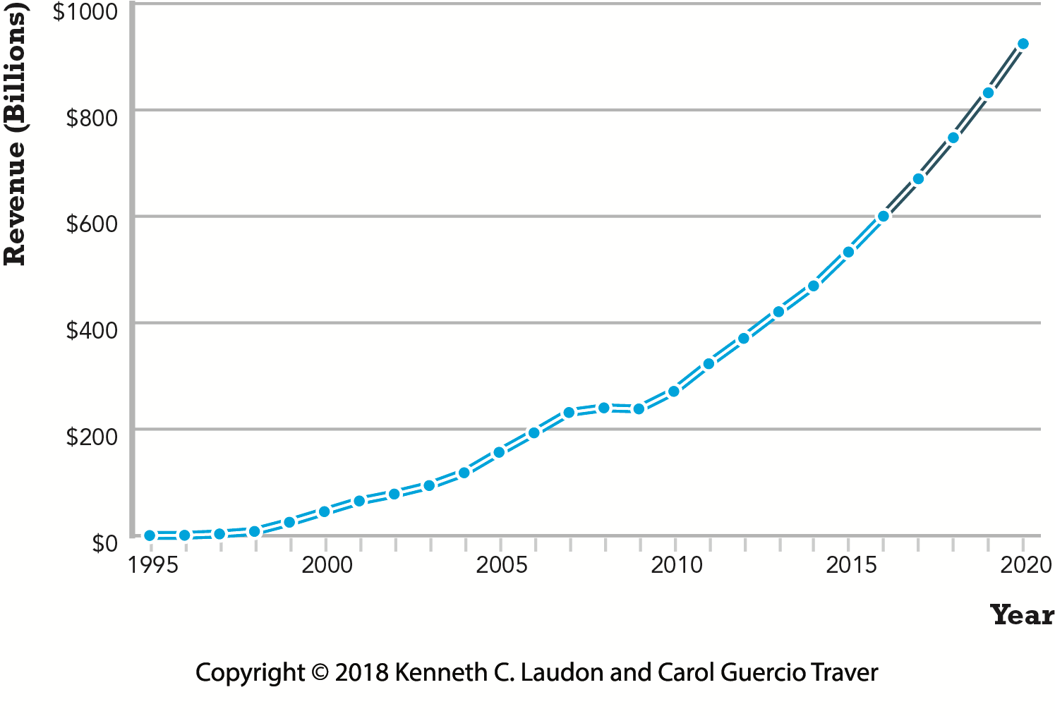
Figure 1.5: The Growth of B2C E-commerce in the U.S.
美國B2C電子商務的發展
收入（百萬）
年
Notes:
Figure 1.5, Page 23.
In the early years, B2C e-commerce was doubling or tripling each year. Although B2C e-commerce growth in the United States slowed in 2008–2009 due to the economic recession, it resumed growing at about 13% in 2010 and since then, has continued to grow at double-digit rates.
SOURCES: Based on data from eMarketer, Inc., 2016e, 2016f; authors’ estimates.

Slide 15
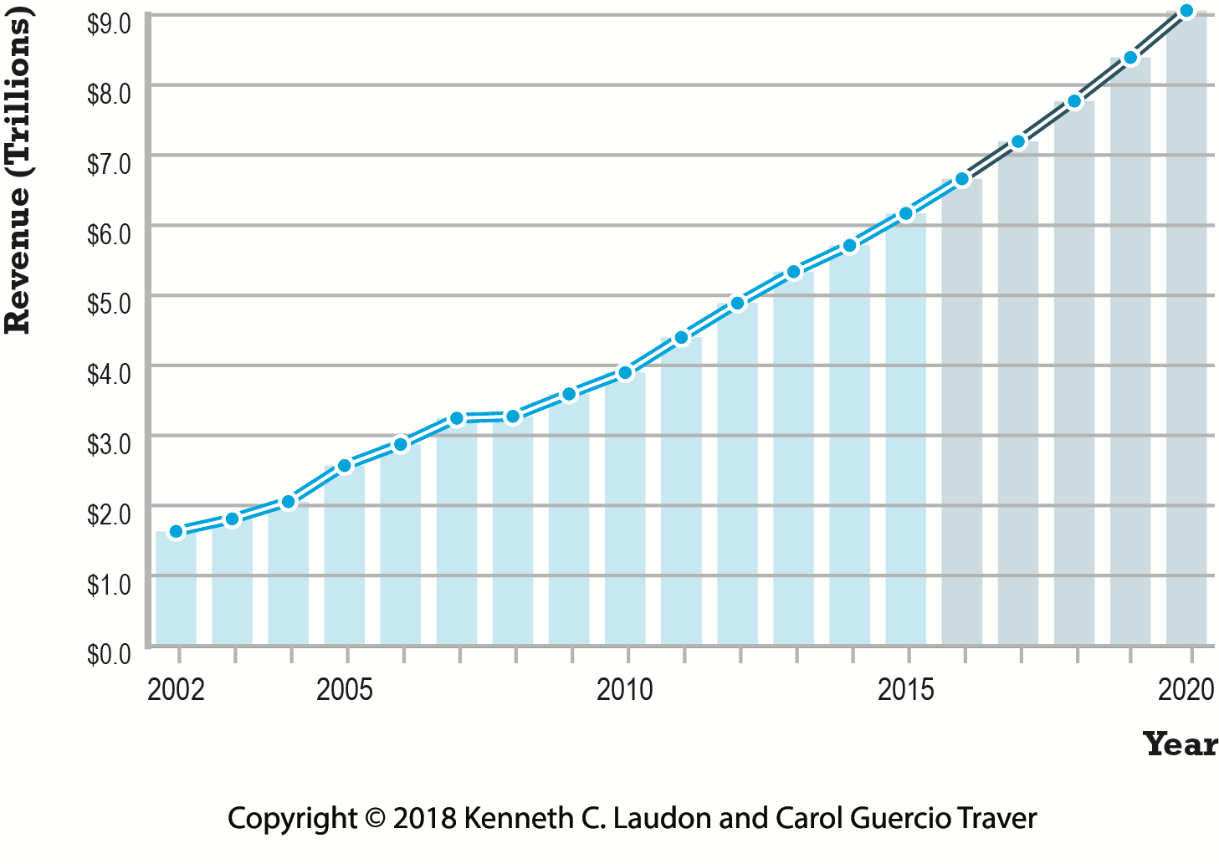
Figure 1.7: The Growth of B2B E-commerce in the U.S.
美國B2B電子商務的發展
收入（百萬）
年
Notes:
Figure 1.7, Page 25.
B2B e-commerce in the United States is about 10 times the size of B2C e-commerce. In 2020, B2B e-commerce is projected to be over $9 trillion. (Note: Does not include EDI transactions.)
SOURCES: Based on data from U.S. Census Bureau, 2016; authors’ estimates.

Slide 16
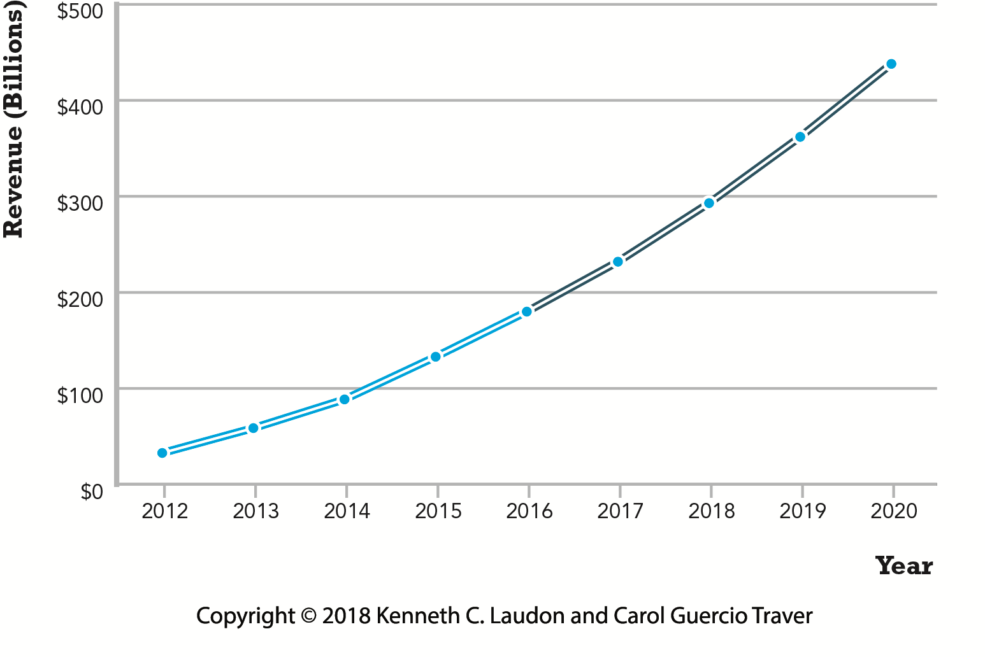
Figure 1.8: The Growth of M-commerce in the United States
行動電子商務在美國的發展
收入（百萬）
年
Notes:
Figure 1.8, page 26.
In the last five years, m-commerce has increased astronomically, from just $32.8 billion in 2012 to over an expected $195 billion in 2016, and it is anticipated that it will continue to grow at double-digit rates over the
next five years as consumers become more and more accustomed to using mobile devices to purchase products and services.
SOURCE: Based on data from eMarketer, Inc., 2016g, 2016h, 2015a, 2015b, 2014.

Slide 17
E-commerce: A Brief History (1 of 4)
電子商務：歷史簡介
Precursors
Baxter Healthcare modem-based system
Order entry systems
Electronic Data Interchange (EDI) standards
French Minitel
前導
百特醫療以數據機為基礎的系統
訂單輸入系統
電子數據交換（EDI）標準
法國 Minitel
＊minitel : 是通過電話線路訪問的圖文線上服務，並被認為是萬維網出現前世界上最成功的線上服務之一。

Slide 18
E-commerce: A Brief History (2 of 4)
電子商務:簡短歷程
1995-2000:發明
1995–2000: Invention
Sale of simple retail goods
Limited bandwidth and media
Euphoric visions of
Friction-free commerce
First-mover advantages
Dot-com crash of 2000
簡易零售商品的銷售
受限的頻寬和媒體
(下列兩項)之樂見願景
零阻力商務
先驅優勢
互聯網泡沫
Notes:
Additional concepts include disintermediation, monopoly profits, switching costs, network effects, disrupting traditional channels.
隨著網路技術的發展某些產品的生產和交易成本(如複製一個軟體)逼近於零

Slide 19
E-commerce: A Brief History (3 of 4)
電子商務:簡短歷程
合併
2001–2006: Consolidation
Emphasis on business-driven approach
Traditional large firms expand presence
Start-up financing shrinks
More complex products and services sold
Growth of search engine advertising
Business Web presences expand
商業驅動方法的重視
傳統型大規模公司商號大量湧現
剛起步之企業所需的融資減少
銷售更加多元的產品和服務
搜尋引擎廣告的增加
傳統型大規模公司商號大量湧現

Slide 20
E-commerce: A Brief History (4 of 4)
電子商務:簡短歷程
現今: 再造
2007–Present: Reinvention
Rapid growth of:
Web 2.0, including online social networks
Mobile platform
Local commerce
On-demand service economy
Entertainment content develops as source of revenues
Transformation of marketing
迅速成長:
Web 2.0, 包含線上社交網路
移動式平台
本地商務
隨選服務經濟
娛樂內容發展成為收入來源
行銷轉型

Slide 21
Figure 1.10: Periods in the Development of E-commerce
電子商務發展時期
發明 零售
合併 零售+服務
再造 (社交型,移動型,本地型) 零售+服務+內容
零售
十億
服務
現金
智慧型手機
內容
Notes:
Figure 1.10, page 29.

Slide 22
Insight on Business: Start-up Boot Camp
洞察商業:新興小型企業新兵訓練營
課程討論
Class Discussion
Why do you think investors today are still interested in investing in start-ups?
What are the benefits of investing in a company that is a graduate of a Y Combinator boot camp?
Is an incubator the best solution for start-ups to find funding? Why or why not?
你認為是什麼原因使得投資者在現金仍對投資創業公司保有興趣?
投資從Y Combinator訓練營畢業的公司有什麼好處？
企業孵化器對創業公司來說是尋找資金最加的解決方法嗎? 說明贊同或不贊同的原因。

Slide 23
Assessing E-commerce (1 of 2)
電子商務評估
Stunning technological success
Early years a mixed business success
Few early dot-coms have survived
Online sales growing rapidly
Many early visions not fulfilled
Price dispersion
Information asymmetry
New intermediaries
令人驚嘆的技術成功
早年混雜的商業有成功
很少有早期的網絡公司倖存下來
在線銷售增長迅速
很多早期的願景沒有實現
價格分散
信息不對稱
新的中介

Slide 24
Assessing E-commerce (2 of 2)
Other surprises
Fast-follower advantages
Start-up costs
Impact of mobile platform
Emergence of on-demand e-commerce
其他驚喜
快速追隨者的優勢
啟動成本
移動平台的影響
電子商務需求的出現

Slide 25
Understanding E-commerce: Organizing Themes
了解電子商務：組織主題
Technology:
Development and mastery of digital computing and communications technology
Business:
New technologies present businesses with new ways of organizing production and transacting business
Society:
Intellectual property, individual privacy, public welfare policy
技術
數位計算和通信技術的發展和掌握
商業
新技術為企業提供組織生產和交易業務的新方式
社會
智慧財產權，個人隱私，公共福利政策

Slide 26
Figure 1.11: The Internet and the Evolution of Corporate Computing
計算機技術
商業應用
交易自動化
工資表
應收賬款
大型計算機
業務功能自動化
營銷
人力資源
設計
小型主機
桌面自動化字處理
電子表格
資料庫
個人電腦
工作組自動化
文件共享
項目管理
消息傳遞電子郵件
圖1.11：互聯網和企業計算的演變
區域網路
企業範圍的計算
網際網路、網絡移動平台、雲端計算
工業系統自動化
供應鏈管理
客戶關係管理
渠道管理系統
網絡和雲服務
企業範圍的自動化
資源規劃系統
綜合金融製造系統
人力資源規劃
Notes:
Figure 1.11, page 39.
The Internet and Web, and the emergence of a mobile platform held together by the Internet cloud, are the latest in a chain of evolving technologies and related business applications, each of which builds on its predecessors.

Slide 27
Insight on Society: Facebook and the Age of Privacy
對社會的見解：Facebook和隱私時代
Class discussion:
Why are social network sites interested in collecting user information?
What types of privacy invasion are described in the case? Which is the most privacy-invading, and why?
Is e-commerce any different than traditional markets with respect to privacy? Don’t merchants always want to know their customer?
How do you protect your privacy on the Web?
課堂討論
為什麼社交網站有興趣收集用戶信息？
你如何保護你的網絡隱私？
電子商務在隱私方面與傳統市場有什麼不同？ 商家不會總是想知道他們的客戶？
案件中描述了哪些類型的隱私入侵？ 哪個是隱私侵犯最多的，為什麼？

Slide 28
Academic Disciplines Concerned with Technology
與技術有關的學術學科
Technical
Computer science, management science, information systems
Behavioral
Information systems research, economics, marketing, management, finance/accounting, sociology
技術
計算機科學，管理科學，信息系統
行為的
信息系統研究，經濟學，市場營銷，管理，財務/會計，社會學

